Slide 1
Working with Sequential Data Transformer
Alexey Zaytsev
Rodrigo Rivera
January, 2020

Slide 2
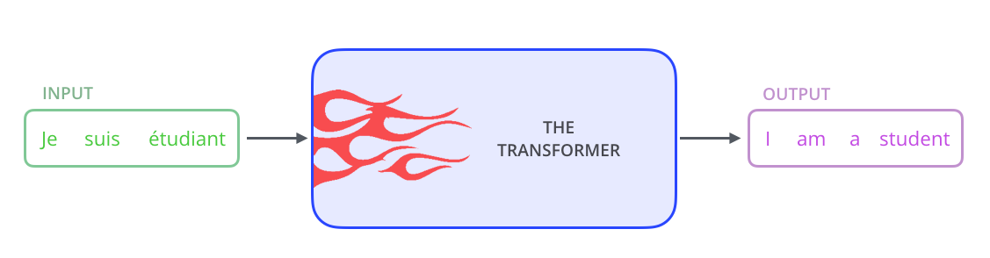
Transformer
Attention is a concept that helped improve the performance of neural machine translation applications.
Now, we will look at The Transformer – a model that uses attention to boost the speed with which these models can be trained.
The Transformers outperforms the Google Neural Machine Translation model in specific tasks.
The biggest benefit, however, comes from how The Transformer lends itself to parallelization.
The Transformer was proposed in the paper Attention is All You Need.

Slide 3
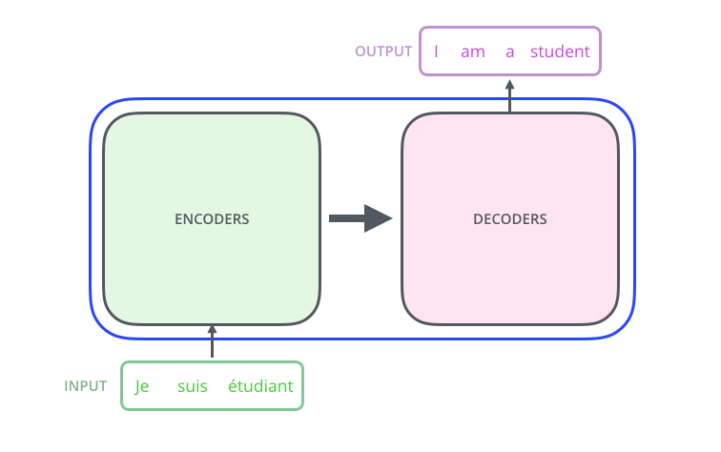
Transformer
At its core, The Tranformer consists of an encoding component, a decoding component, and connections between them.

Slide 4
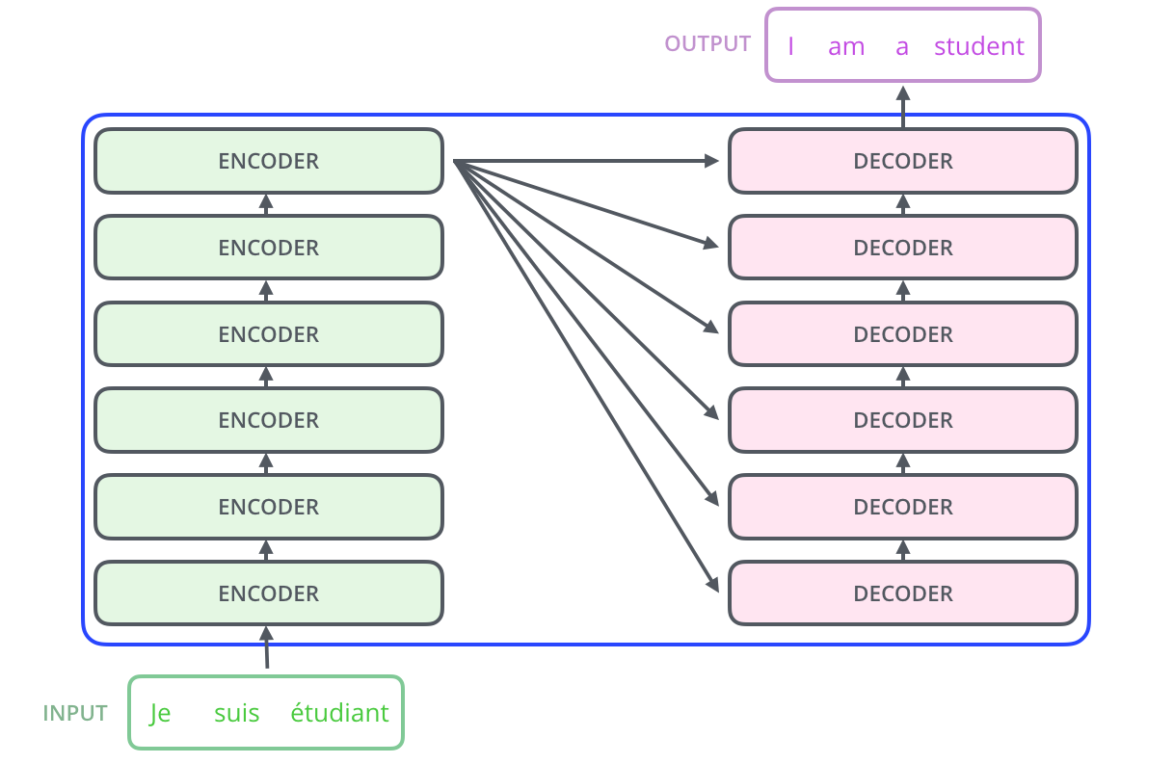
Transformer
The encoding component is a stack of encoders
The paper stacks six of them on top of each other, one can definitely experiment with other arrangements.
The decoding component is a stack of decoders of the same number.

Slide 5
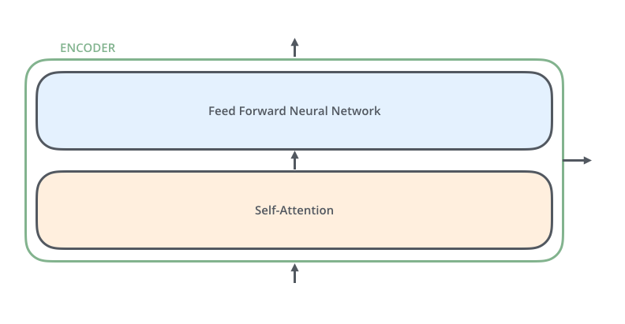
Transformer
The encoders are all identical in structure
They they do not share weights.
Each one is broken down into two sub-layers:

Slide 6
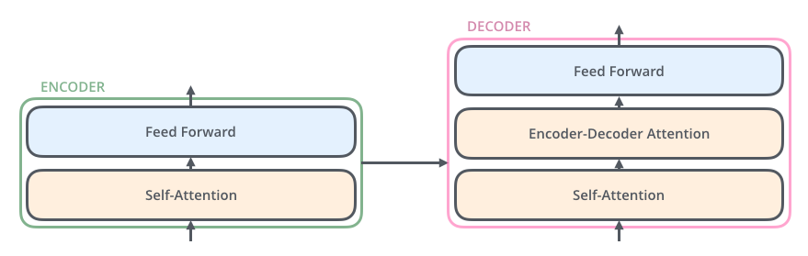
Transformer
The encoder’s inputs first flow through a self-attention layer
The layer helps the encoder look at other words in the input sentence as it encodes a specific word.
The outputs of the self-attention layer are fed to a feed-forward neural network.
The exact same feed-forward network is independently applied to each position.
The decoder has both those layers, but between them is an attention layer that helps the decoder focus on relevant parts of the input sentence
This is similar what attention does in sequence to sequence models.

Slide 7
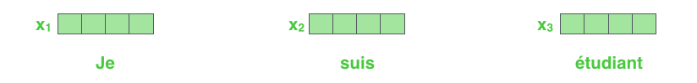
Transformer
One begins by turning each input word into a vector using an embedding algorithm.

Slide 8
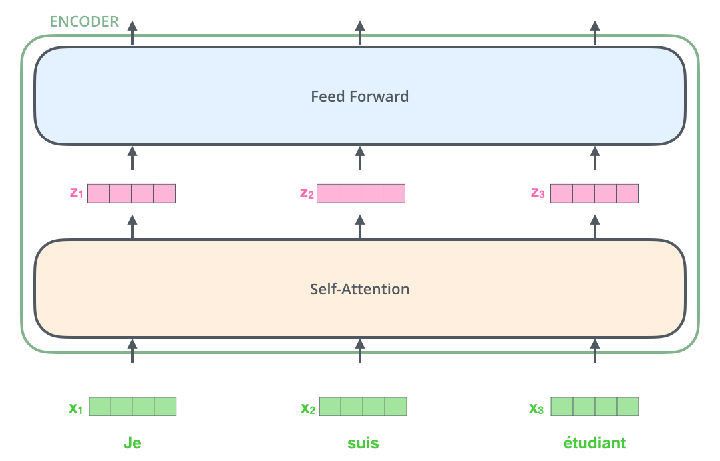
Transformer
The embedding only happens in the bottom-most encoder.
The abstraction that is common to all the encoders is that they receive a list of vectors each of the size 512

Slide 9
Transformer
In the bottom encoder that would be the word embeddings, but in other encoders, it would be the output of the encoder that is directly below.
The size of this list is a hyperparameter. It would be the length of the longest sentence in our training dataset.

Slide 10
Transformer
After embedding the words in our input sequence, each of them flows through each of the two layers of the encoder.

Slide 11
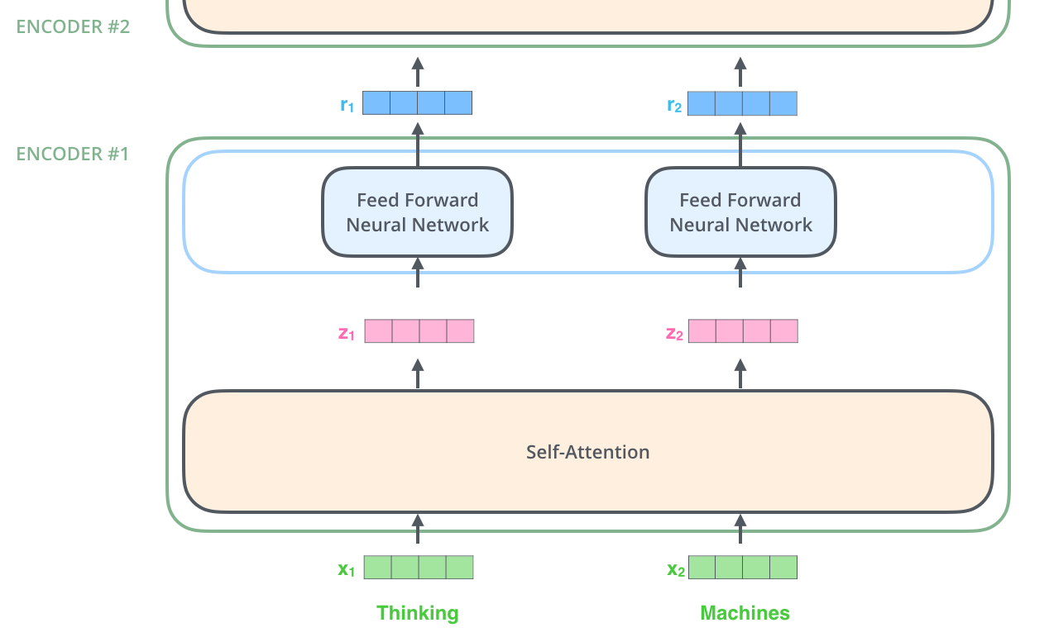
Transformer
The word in each position flows through its own path in the encoder.
There are dependencies between these paths in the self-attention layer.
The feed-forward layer does not have those dependencies, however, and thus the various paths can be executed in parallel while flowing through the feed-forward layer.

Slide 12
Transformer
The encoder receives a list of vectors as input. It processes this list by passing these vectors into a ‘self-attention’ layer, then into a feed-forward neural network, then sends out the output upwards to the next encoder.

Slide 13
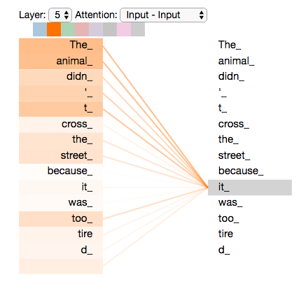
Self-Attention
Say the following sentence is an input sentence we want to translate:
”The animal didn't cross the street because it was too tired”
What does “it” in this sentence refer to? Is it referring to the street or to the animal? It’s a simple question to a human, but not as simple to an algorithm.
When the model is processing the word “it”, self-attention allows it to associate “it” with “animal”.
As we are encoding the word "it" in encoder #5 (the top encoder in the stack), part of the attention mechanism was focusing on "The Animal", and baked a part of its representation into the encoding of "it".

Slide 14
Self-Attention
As the model processes each word (each position in the input sequence), self attention allows it to look at other positions in the input sequence for clues that can help lead to a better encoding for this word.
This is akin to RNNs maintaining a hidden state. It allows an RNN to incorporate its representation of previous words/vectors it has processed with the current one it’s processing. Self-attention is the method the Transformer uses to bake the “understanding” of other relevant words into the one we’re currently processing.
As we are encoding the word "it" in encoder #5 (the top encoder in the stack), part of the attention mechanism was focusing on "The Animal", and baked a part of its representation into the encoding of "it".

Slide 15
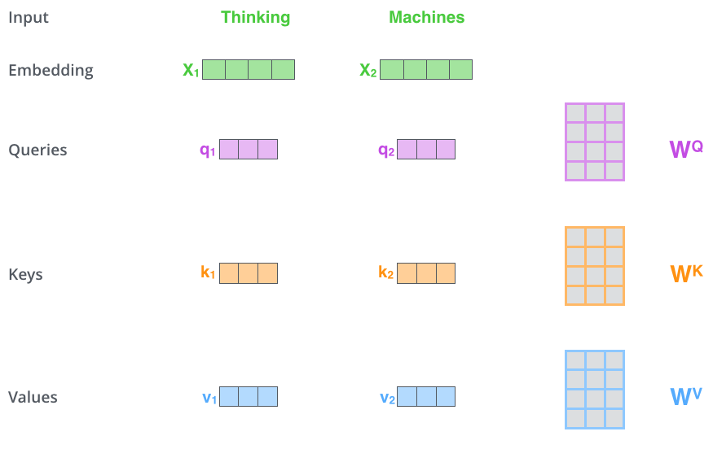
Self-Attention in detail
The first step in calculating self-attention is to create three vectors from each of the encoder’s input vectors (in this case, the embedding of each word).
So for each word, create a Query vector, a Key vector, and a Value vector.
These vectors are created by multiplying the embedding by three matrices that we trained during the training process.

Slide 16
Self-Attention in detail
Notice that these new vectors are smaller in dimension than the embedding vector.
Their dimensionality is 64, while the embedding and encoder input/output vectors have dimensionality of 512.
They do not HAVE to be smaller, this is an architecture choice to make the computation of multiheaded attention (mostly) constant.
The first step out of six starts by multiplying x1 by the WQ weight matrix produces q1, the "query" vector associated with that word.
This creates a "query", a "key", and a "value" projection of each word in the input sentence.

Slide 17
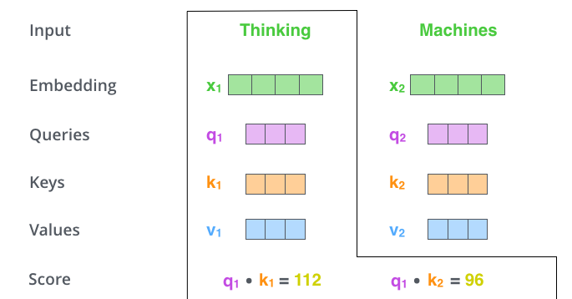
Self-Attention in detail
The second step consists in calculating self-attention is to calculate a score.
Example: To calculate the self-attention for the first word, “Thinking”, we need to score each word of the input sentence against this word.
The score determines how much focus to place on other parts of the input sentence as we encode a word at a certain position.
The score is calculated by taking the dot product of the query vector with the key vector of the respective word we’re scoring.
If we’re processing the self-attention for the word in position #1, the first score would be the dot product of q1 and k1.
The second score would be the dot product of q1 and k2.

Slide 18
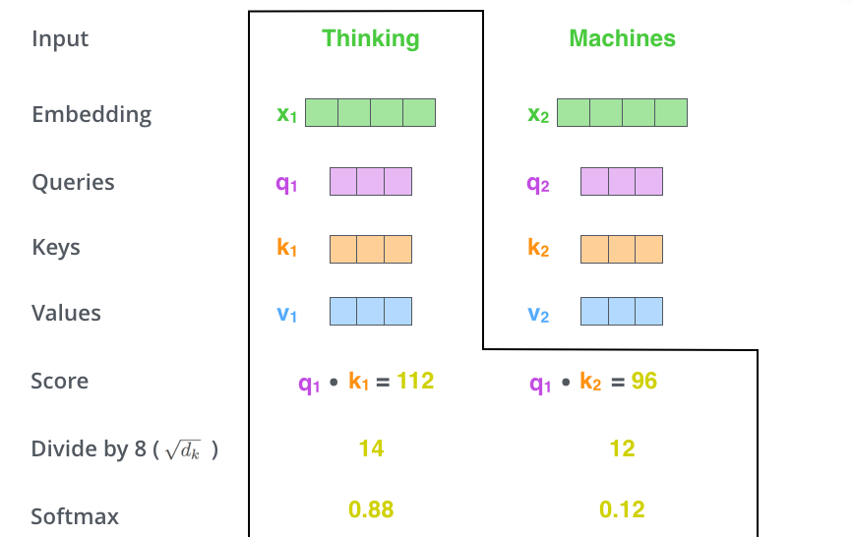
Self-Attention in detail
The third step is to divide the scores by 8.
This is the square root of the dimension of the key vectors used in the paper – 64.
It leads to having more stable gradients. Other values are possible.

Slide 19
Self-Attention in detail
In the fourth step, pass the result through a softmax operation.
Softmax normalizes the scores so they’re all positive and add up to 1.
The softmax score determines how much how much each word will be expressed at this position.
Clearly the word at this position will have the highest softmax score
Sometimes it’s useful to attend to another word that is relevant to the current word.

Slide 20
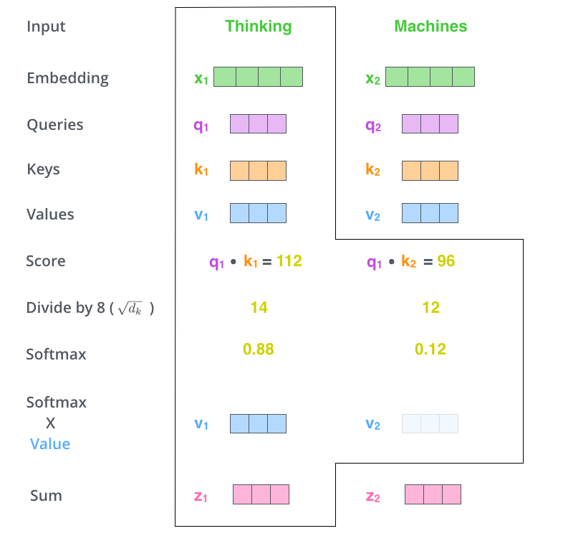
Self-Attention in detail
The fifth step out of six steps is to multiply each value vector by the softmax score (in preparation to sum them up).
The intuition here is to keep intact the values of the word(s) to focus on, and drown-out irrelevant words (by multiplying them by tiny numbers like 0.001, for example).

Slide 21
Self-Attention in detail
The sixth step is to sum up the weighted value vectors.
This produces the output of the self-attention layer at this position (for the first word).
The resulting can be sent to the feed-forward neural network.
In the actual implementation, this calculation is done in matrix form for faster processing

Slide 22
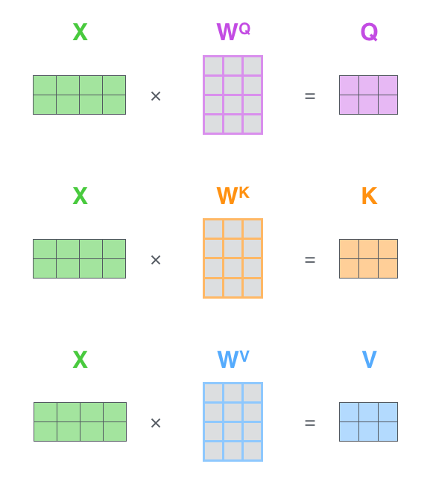
Matrix Calculation of Self-Attention
The first step is to calculate the Query, Key, and Value matrices.
Do that by packing the embeddings into a matrix X, and multiplying it by the weight matrices trained (WQ, WK, WV).
Every row in the X matrix corresponds to a word in the input sentence.
See the difference in size of the embedding vector (512, or 4 boxes in the figure), and the q/k/v vectors (64, or 3 boxes in the figure)

Slide 23
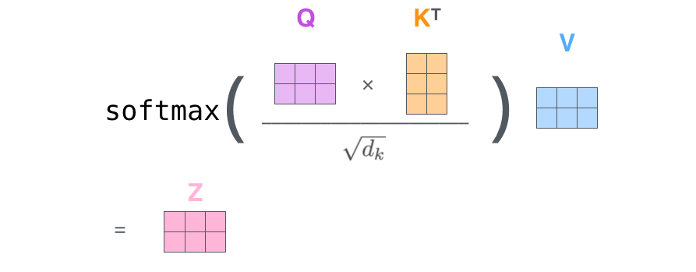
Matrix Calculation of Self-Attention
Finally, we can condense steps two through six in one formula to calculate the outputs of the self-attention layer.

Slide 24
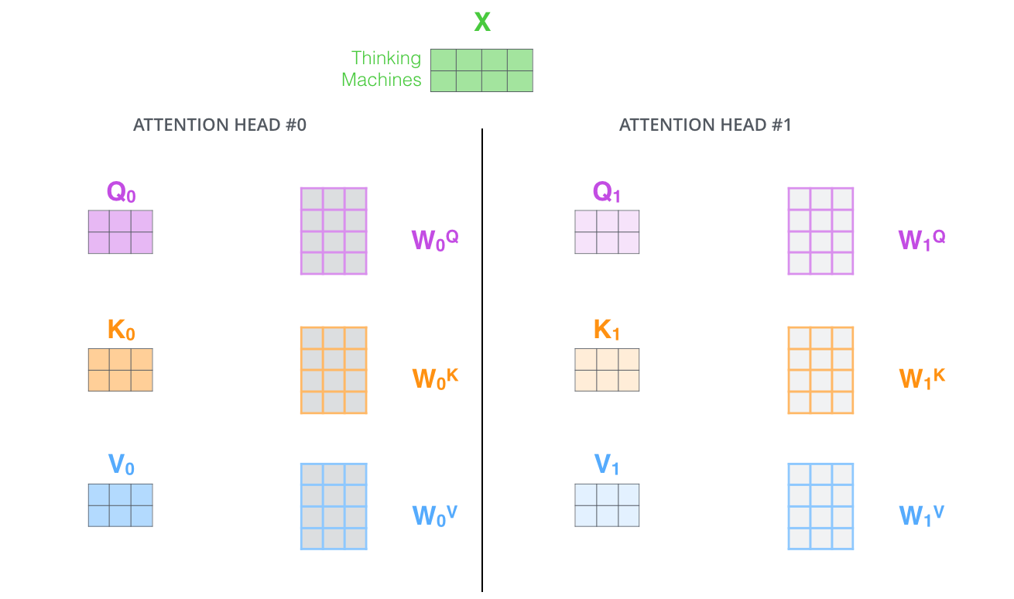
“Multi-headed” attention
It expands the model’s ability to focus on different positions.
In the example, z1 contains a little bit of every other encoding, but it could be dominated by the the actual word itself.
It would be useful if we’re translating a sentence like “The animal didn’t cross the street because it was too tired”, we would want to know which word “it” refers to.
With multi-headed attention, one maintains separate Q/K/V weight matrices for each head resulting in different Q/K/V matrices. As before, multiplying X by the WQ/WK/WV matrices produce Q/K/V matrices.

Slide 25
“Multi-headed” attention
It gives the attention layer multiple “representation subspaces”.
With multi-headed attention, one has multiple sets of Query/Key/Value weight matrices
The Transformer uses eight attention heads, so eight sets for each encoder/decoder.
Each of these sets is randomly initialized. Then, after training, each set is used to project the input embeddings (or vectors from lower encoders/decoders) into a different representation subspace.

Slide 26
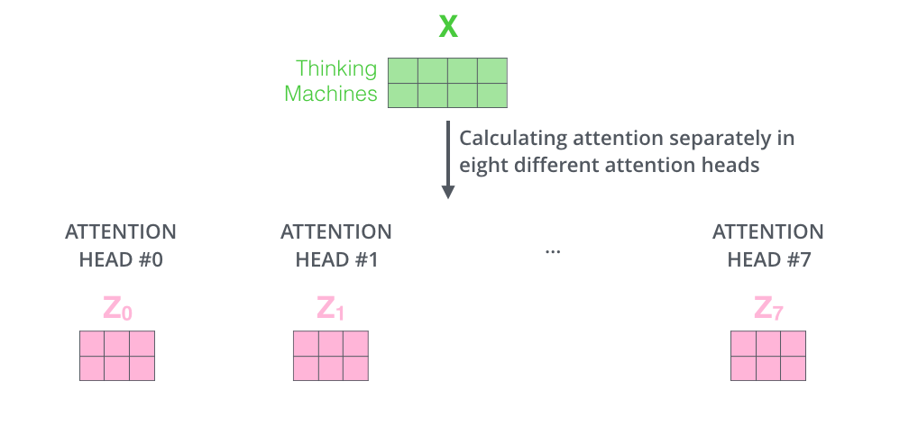
“Multi-headed” attention
If we do the same self-attention calculation, just eight different times with different weight matrices, we end up with eight different Z matrices
The feed-forward layer is not expecting eight matrices
It is expecting a single matrix, a vector for each word.
We need a way to condense these eight down into a single matrix.

Slide 27
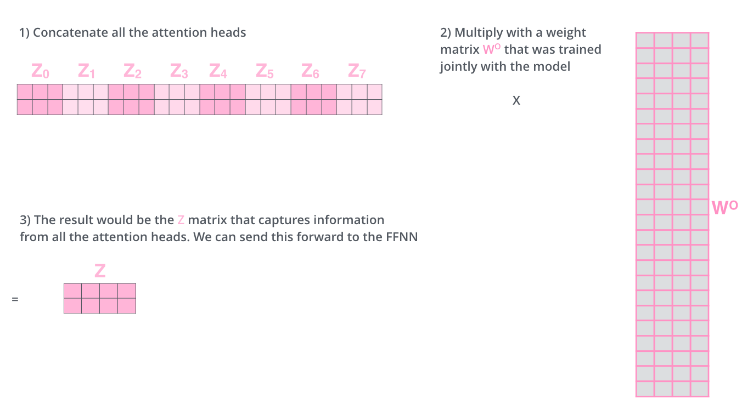
“Multi-headed” attention
Concatenate the matrices
Multiply them by an additional weights matrix WO.

Slide 28
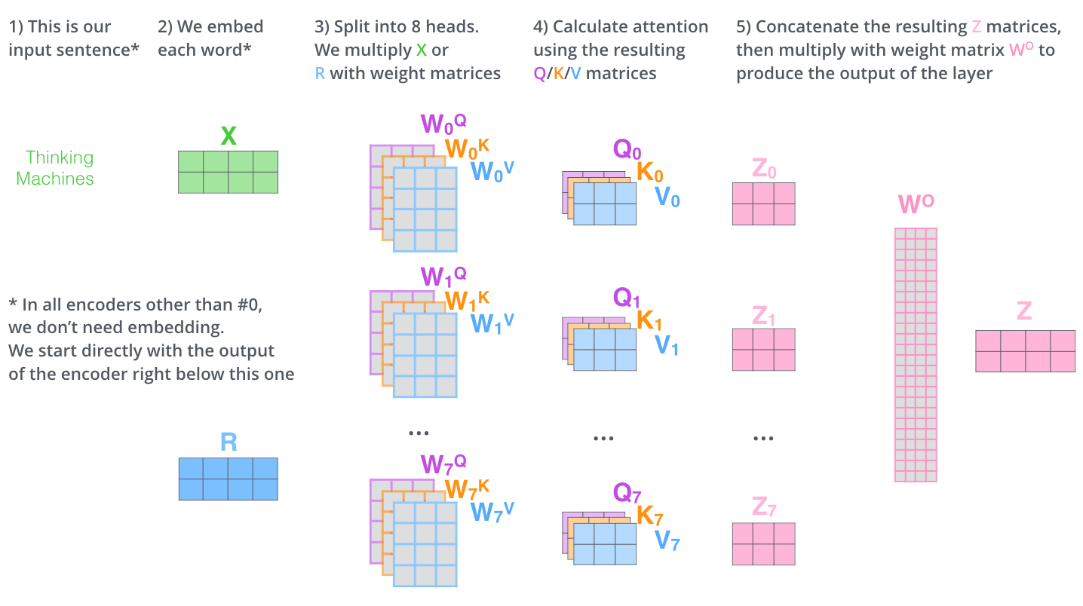
“Multi-headed” attention

Slide 29
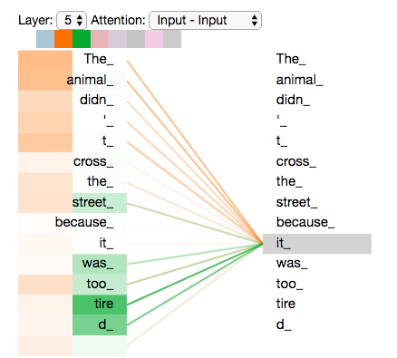
Self-Attention
As we encode the word "it", one attention head is focusing most on "the animal", while another is focusing on "tired”
In a sense, the model's representation of the word "it" bakes in some of the representation of both "animal" and "tired".

Slide 30
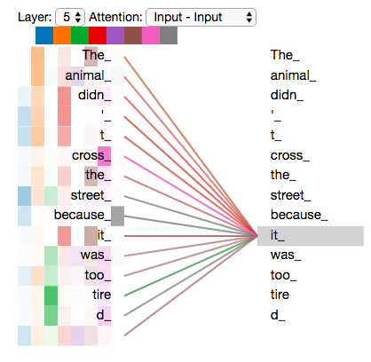
Self-Attention
If we add all the attention heads to the picture, it can be harder to interpret

Slide 31
Representing the order of the sequence
How to account for the order of the words in the input sequence?

Slide 32
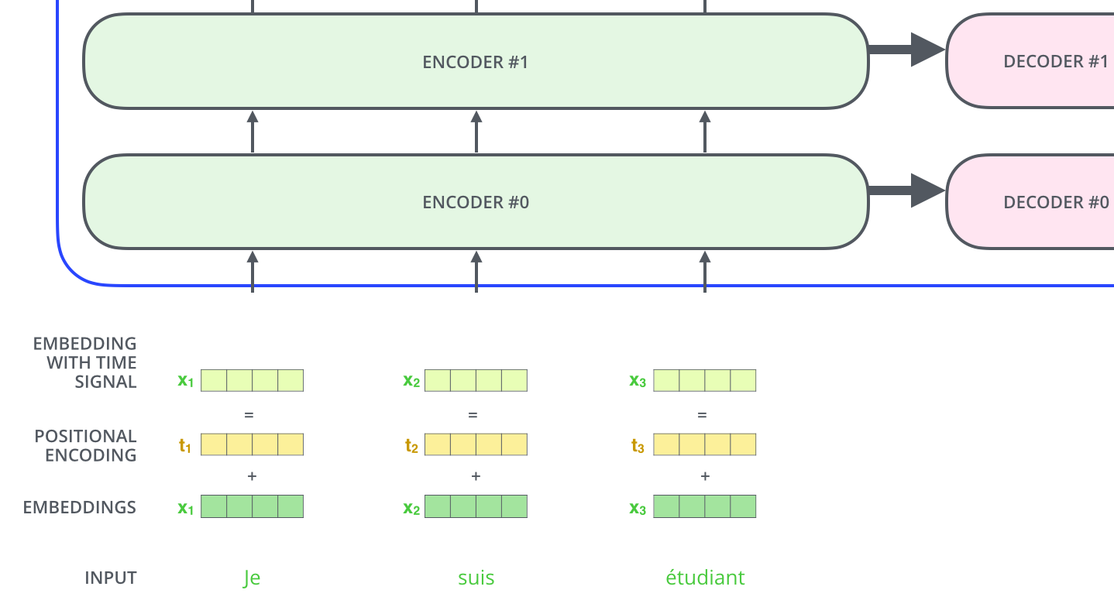
Representing the order of the sequence
To give the model a sense of the order of the words, add positional encoding vectors They are the values of which follow a specific pattern.

Slide 33
Representing the order of the sequence
The transformer adds a vector to each input embedding.
These vectors follow a specific pattern that the model learns, which helps it determine the position of each word, or the distance between different words in the sequence.
The intuition here is that adding these values to the embeddings provides meaningful distances between the embedding vectors once they’re projected into Q/K/V vectors and during dot-product attention.

Slide 34
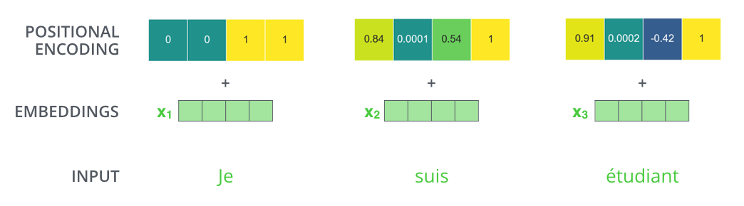
Stating the Problem
Assuming the embedding has a dimensionality of 4, the actual positional encodings would look like this

Slide 35
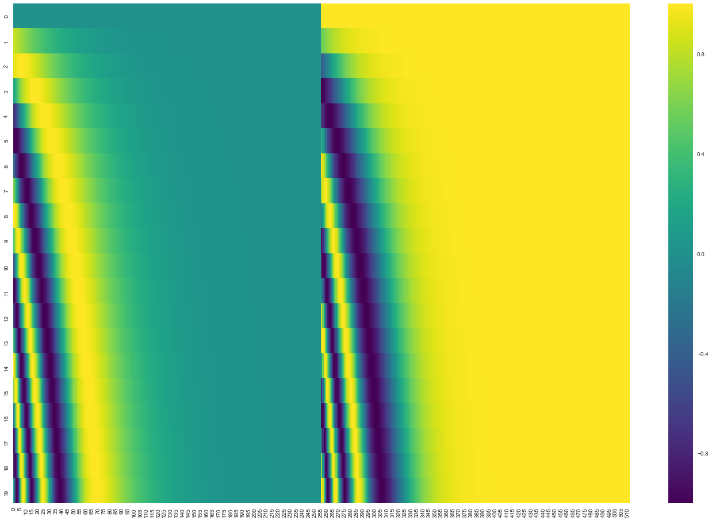
Stating the Problem
Wach row corresponds the a positional encoding of a vector.
The first row would be the vector we’d add to the embedding of the first word in an input sequence.
Each row contains 512 values – each with a value between 1 and -1.
It is color-coded so the pattern is visible.
Positional encoding for 20 words (rows) with an embedding size of 512 (columns). One can see that it appears split in half down the center. That's because the values of the left half are generated by one function (which uses sine), and the right half is generated by another function (which uses cosine). They're then concatenated to form each of the positional encoding vectors.

Slide 36
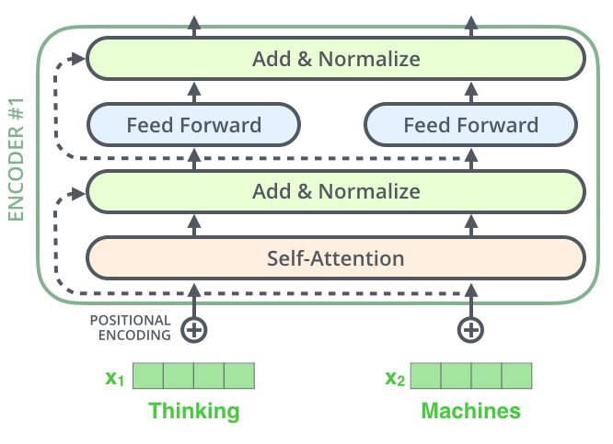
The Residuals
Each sub-layer in each encoder has a residual connection around it, and is followed by a layer-normalization step.

Slide 37
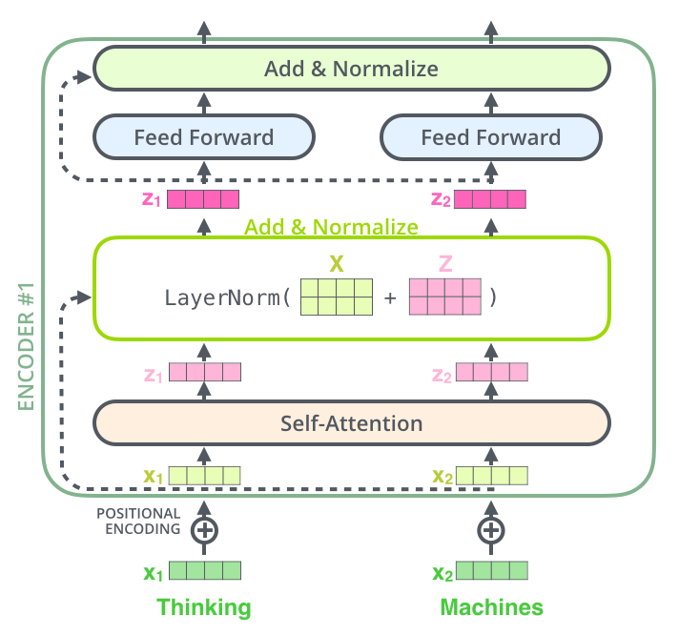
The Residuals
Visualizing the vectors and the layer-norm operation associated with self attention

Slide 38
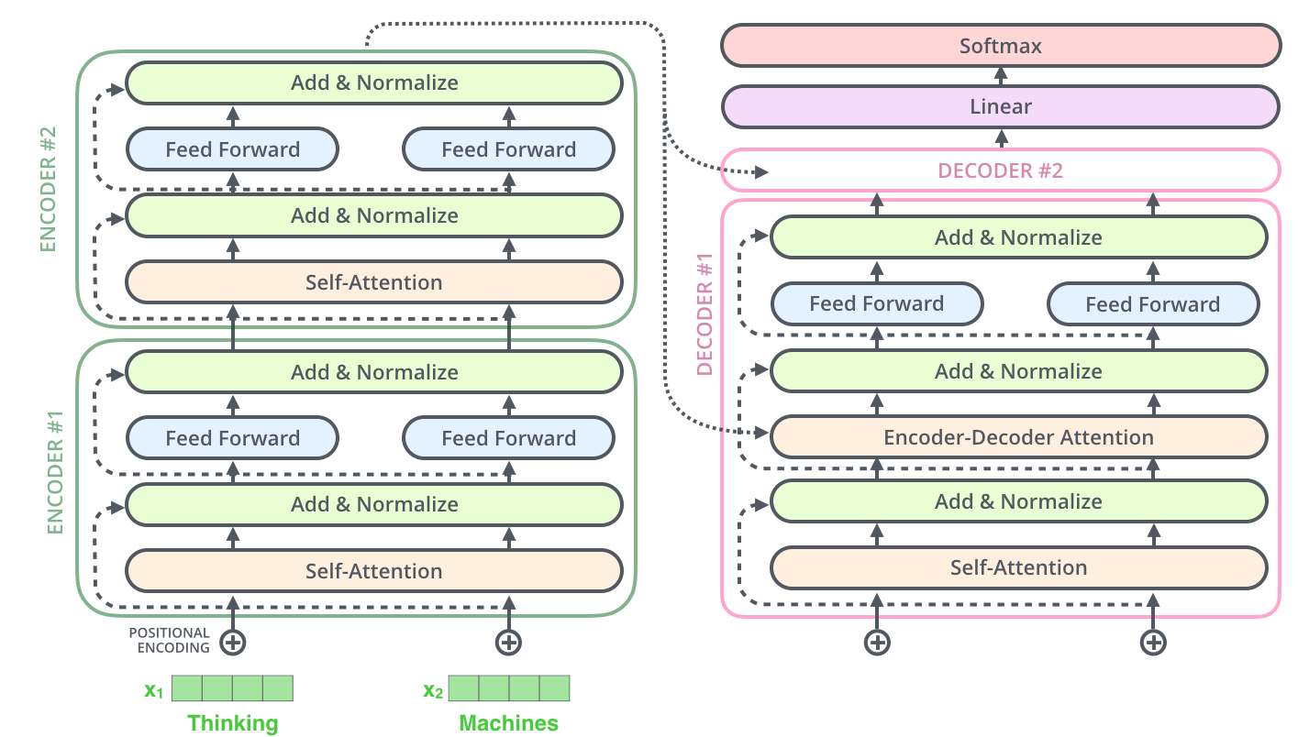
The Residuals
This goes for the sub-layers of the decoder as well.

Slide 39
The Decoder
The encoder start by processing the input sequence.
The output of the top encoder is then transformed into a set of attention vectors K and V.
These are to be used by each decoder in its “encoder-decoder attention” layer which helps the decoder focus on appropriate places in the input sequence.
After finishing the encoding phase, begin with the decoding phase. Each step in the decoding phase outputs an element from the output sequence The English translation sentence in this case.

Slide 40
The Decoder
The following steps repeat the process until a special symbol is reached indicating the transformer decoder has completed its output.
The output of each step is fed to the bottom decoder in the next time step, and the decoders bubble up their decoding results just like the encoders did.
One embeds and adds positional encoding to those decoder inputs to indicate the position of each word.

Slide 41
The Decoder
The self attention layers in the decoder operate in a slightly different way than the one in the encoder
In the decoder, the self-attention layer is only allowed to attend to earlier positions in the output sequence.
This is done by masking future positions (setting them to -inf) before the softmax step in the self-attention calculation.

Slide 42
The Decoder
The self attention layers in the decoder operate in a slightly different way than the one in the encoder
The “Encoder-Decoder Attention” layer works just like multiheaded self-attention, except it creates its Queries matrix from the layer below it, and takes the Keys and Values matrix from the output of the encoder stack.

Slide 43
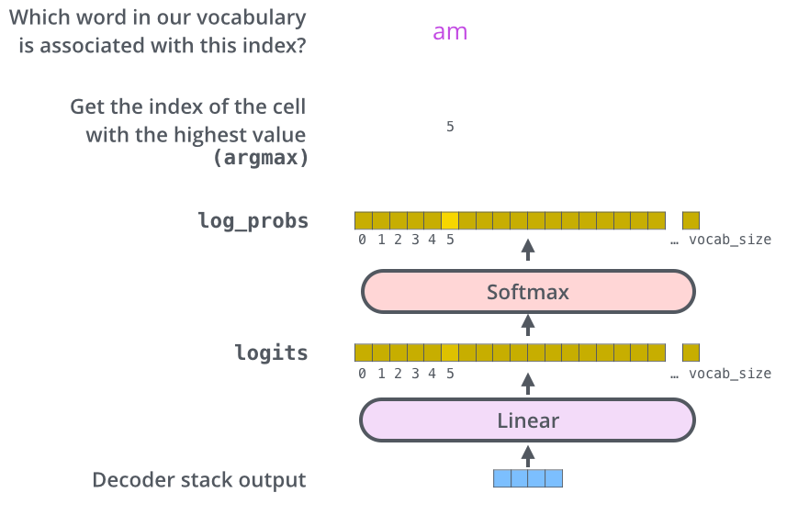
The softmax layer
The decoder stack outputs a vector of floats. How to turn that into a word?
That is the job of the final Linear layer which is followed by a Softmax Layer.
The Linear layer is a simple fully connected neural network that projects the vector produced by the stack of decoders, into a much, much larger vector called a logits vector.
Let’s assume that our model knows 10,000 unique English words (our model’s “output vocabulary”) that it’s learned from its training dataset. This would make the logits vector 10,000 cells wide – each cell corresponding to the score of a unique word. That is how one interprets the output of the model followed by the Linear layer.

Slide 44
The softmax layer
The decoder stack outputs a vector of floats. How to turn that into a word?
That is the job of the final Linear layer which is followed by a Softmax Layer.
The Linear layer is a simple fully connected neural network that projects the vector produced by the stack of decoders, into a much, much larger vector called a logits vector.
The softmax layer then turns those scores into probabilities (all positive, all add up to 1.0). The cell with the highest probability is chosen The word associated with it is produced as the output for this time step.

Slide 45
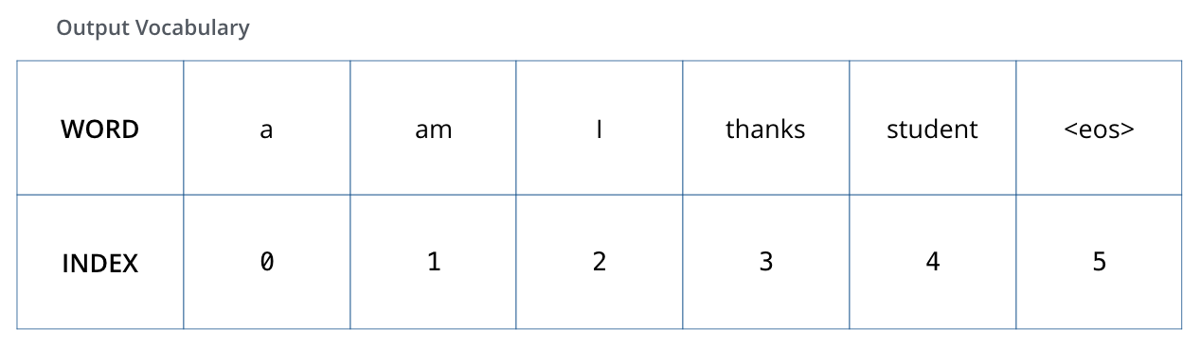
Recap
During training, an untrained model would go through the exact same forward pass. But since it is trained on a labeled training dataset, we can compare its output with the actual correct output.
To visualize this, let’s assume our output vocabulary only contains six words(“a”, “am”, “i”, “thanks”, “student”, and “<eos>” (short for ‘end of sentence’)).

Slide 46
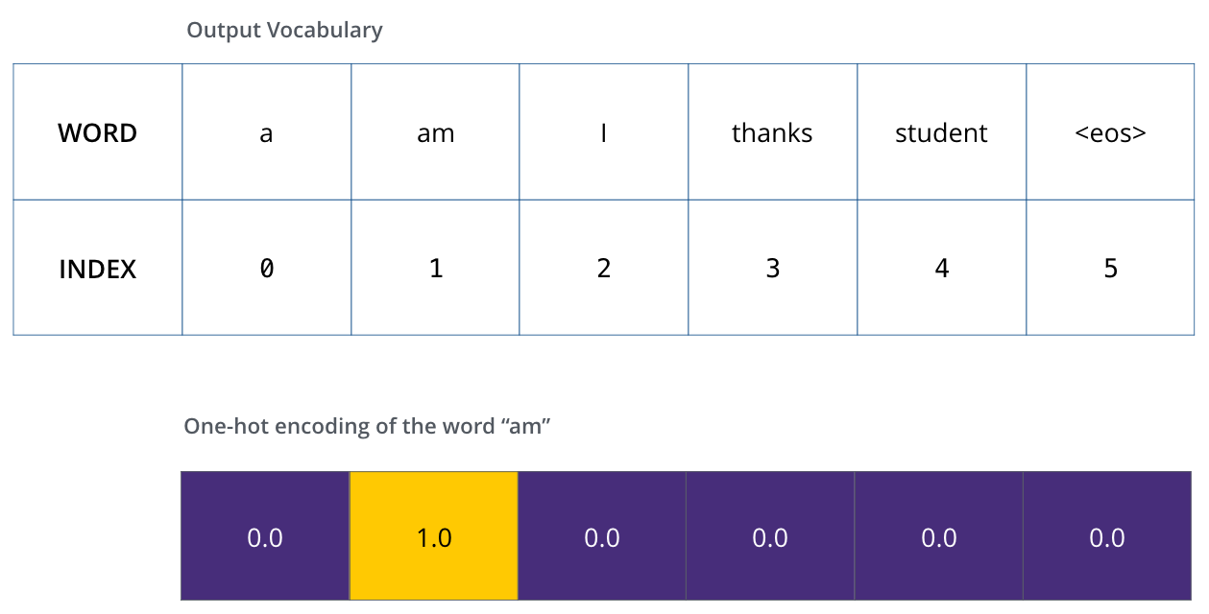
The loss function
Once we define the output vocabulary, we can use a vector of the same width to indicate each word in our vocabulary.
This also known as one-hot encoding.

Slide 47
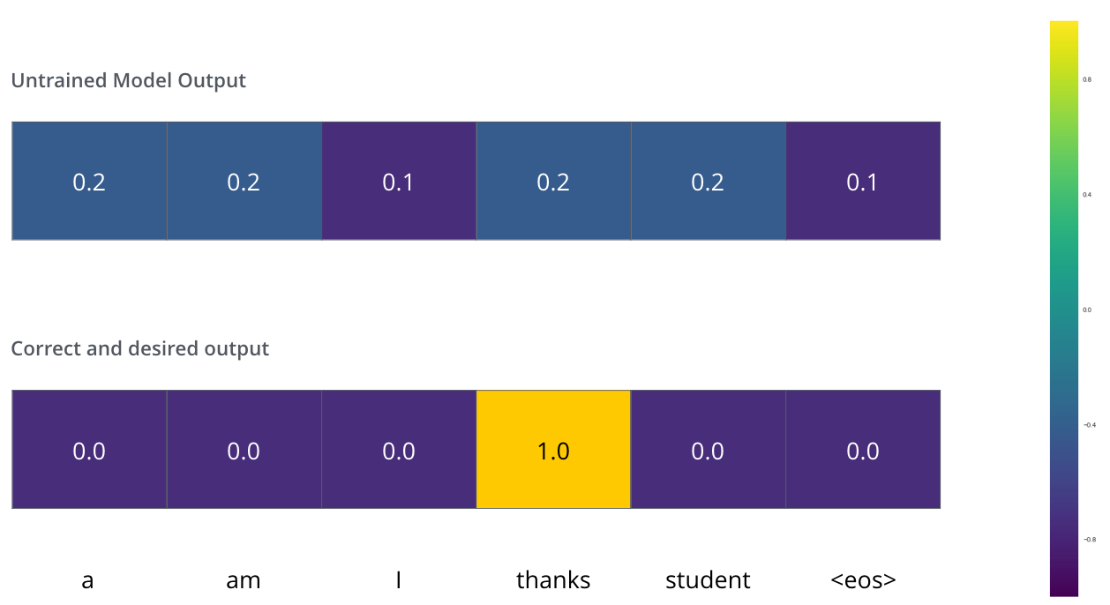
The loss function
Since the model's parameters (weights) are all initialized randomly, the (untrained) model produces a probability distribution with arbitrary values for each cell/word.
We can compare it with the actual output, then tweak all the model's weights using backpropagation to make the output closer to the desired output.

Slide 48
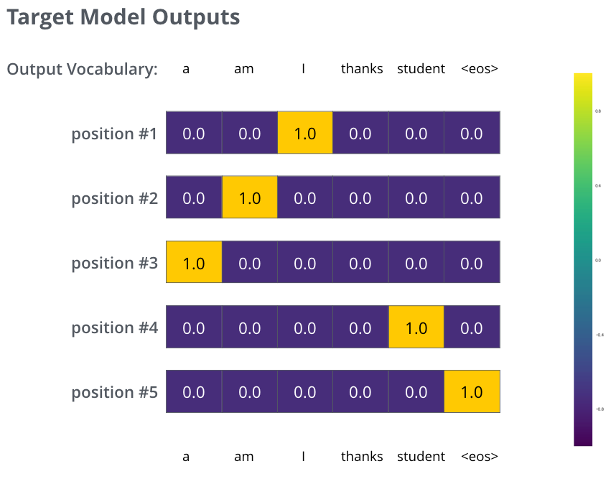
The loss function
How to compare two probability distributions? Simply subtract one from the other. For more details, look at cross-entropy and Kullback–Leibler divergence.
Realistically, sentences are longer than one word. For example – input: “je suis étudiant” and expected output: “i am a student”. What this really means, is that we want our model to successively output probability distributions
Each probability distribution is represented by a vector of width vocab_size (6 in our toy example, but more realistically a number like 3,000 or 10,000).
The first probability distribution has the highest probability at the cell associated with the word “i”.

Slide 49
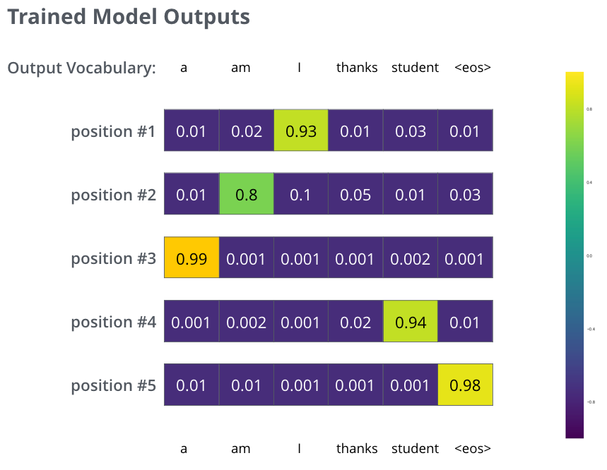
The loss function
How to compare two probability distributions? Simply subtract one from the other. For more details, look at cross-entropy and Kullback–Leibler divergence.
Realistically, sentences are longer than one word. For example – input: “je suis étudiant” and expected output: “i am a student”. What this really means, is that we want our model to successively output probability distributions
The second probability distribution has the highest probability at the cell associated with the word “am”.
And so on, until the fifth output distribution indicates ‘<end of sentence>’ symbol, which also has a cell associated with it from the 10,000 element vocabulary.

Slide 50
The loss function
Greedy Decoding
The model produces the outputs one at a time, one assumes that the model is selecting the word with the highest probability from that probability distribution and throwing away the rest.
Beam search
Another way to do it would be to hold on to the top two words (‘I’ and ‘a’ for example).
In then in the next step, run the model twice:
Once assuming the first output position was the word ‘I’
And another time assuming the first output position was the word ‘a’
Whichever version produced less error considering both positions #1 and #2 is kept. Repeat this for positions #2 and #3…etc.

Slide 51
Questions?

Slide 52
Sources
https://jalammar.github.io/visualizing-neural-machine-translation-mechanics-of-seq2seq-models-with-attention/
http://nlp.seas.harvard.edu/2018/04/03/attention.html
https://jalammar.github.io/illustrated-transformer/

